Slide 1

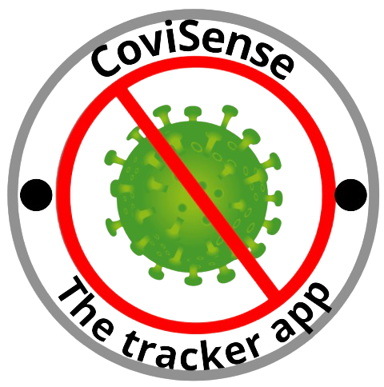
NASA Competition - COVID-19: CALCULATE THE RISK - UWR Legends - CoviSense

Slide 2
Business Statement
Ensuring, many people around the world are informed and aware of Covid 19

Slide 3
Summary Of The Project
SITUATION SUMMARY
GROWTH PREDICTIONS
Covid-19 has and continues to be a global issue, even though several scientific breakthroughs such as vaccines are underway. As of August 2021, the World Health Organization had reported about 199 million COVID-19 cases and 4.24 million fatalities, with the virus causing multibillion-dollar costs. There is a wealth of open-source COVID-related research available online. However, many of these studies are equivocal, necessitating the collection and analysis of further data. Many useful open-source web portals and dashboards show COVID-19 case rates and death in real time, with some displaying potentially related environmental variables.
KEY PREDICTIONS
Existing Situation |  | Future Situation
Limited Statistics Real time updates Limited Application Features |  | Efficient Statistics Seamless Model Expanded application features
App Overview
Predicted Outcomes
Predict rising cases so users will be able to plan their activities Ensure users understand the scale of the situation
Comprehensible data
Showcase data in a comprehensible manner for users to understand Ensure that raw data is provided feasibility
KEY ISSUES WITH EXISTING APPLICATIONS
Only centered around the United States Insufficient valuable data Not centric/ useful for common day users
App Targets
1. Create awareness about covid in the community 2. Encourage social responsibility through guidelines and the raw data 3. Ensure the app grows and supports other regions as well
FINAL RECOMMENDATION: A new designed app that provides users with real time data and predicts rising cases.

Slide 4
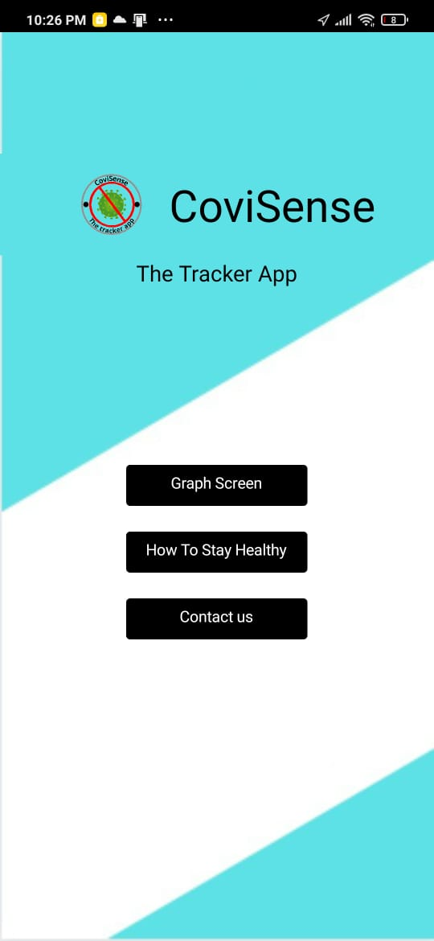

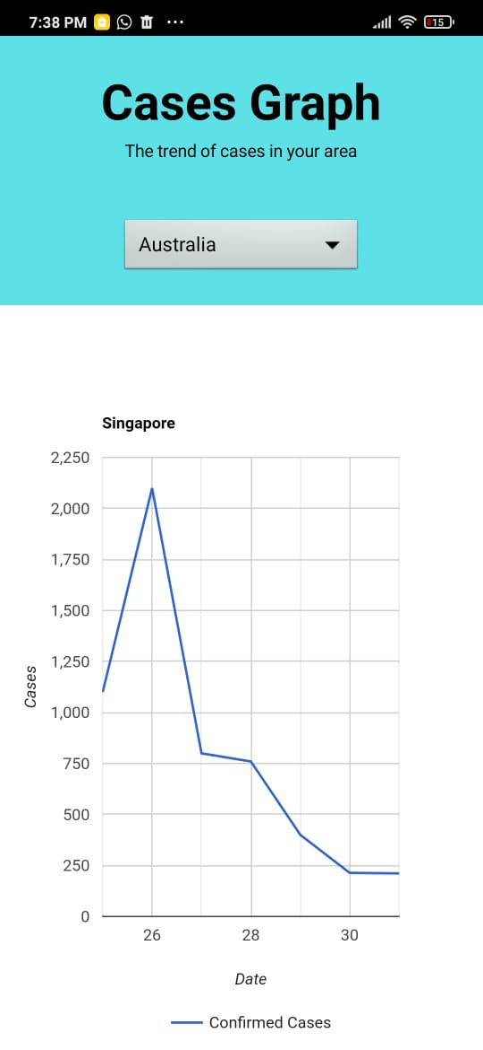
CoviSense - User Interface
We designed the user interface to be the colour mint green and white because that colour combination makes the app look simple, yet sophisticated. We chose white because it symbolises purity and truthfulness, which emphasizes that our data is the official and confirmed recorded cases. We chose the green because it symbolises prosperity and new beginnings, and we provide the user with a belief that there will be a prosperous new beginning to their lives, for the better

Slide 5
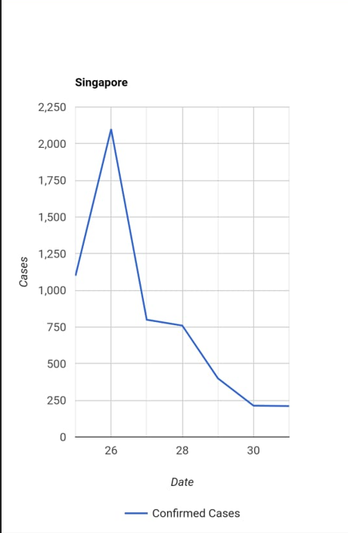
Raw Data - Graphs
Graph
We have implemented graphs using an extension called ChartMaker.
Using NASA’s csv file, we thought line graph would be the best as it is ideal for Covid 19.
It was kind of easy but as we were new to app development, we struggled at the first phase.
Overall, our experience was fascinating. It was a mixture of learning, failing, and the main lesson we learnt was: Always be persistent.

Slide 6
CoviSense notification system
CoviSense uses the following notification system to warn users about the cases in their area:
High growth of cases in the country(5000+ new cases) - The message is: ‘Be careful! The cases in your community are skyrocketing! Please be socially responsible at all times in order to slow the spread!’
Medium-low growth of cases in the country(0-5000 new cases) - The message is: ‘Doing good! the cases in your community arent growing much. Try to follow guidelines to save people around you from catching COVID-19!’
Decline in cases(any negative change in cases) - The message is: ‘Good job! The cases in your community are decreasing thanks to your efforts! Continue being socially responsible to help eradicate COVID-19 completely!’

Slide 7
Thank You

